Slide 1
Annual Arizona NASA Space Grant Consortium Symposium
April 17, 2021
Nonlinear Laser Pulse Compression with a Multipass Cell
Elena Boyd¹ , Dariannette Valentin³, mentored by Dr. Samuel Teitelbaum^{1,2}
¹Department of Physics, The College of Liberal Arts and Sciences, Arizona State University, Tempe, AZ, 85281
²Biodesign Institute, College of Applied Structural Design, Arizona State University, Tempe, AZ, 85281
³School of Earth and Space Exploration, The College of Liberal Arts and Sciences, Arizona State University, Tempe, AZ, 85281

Slide 2
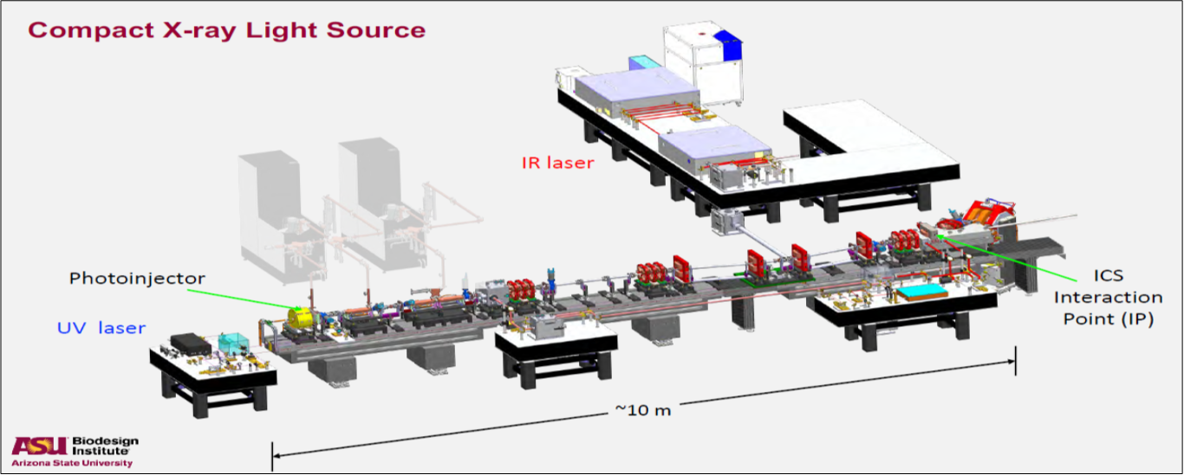
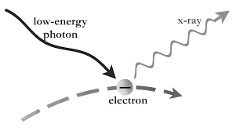
Background
The CXFEL lab is designing a compact ultrafast x-ray source: CXLS
This will allow the lab to perform research on condensed matter systems at lower cost than that of a typical FEL (free-electron laser).
The CXFEL uses inverse Compton scattering, which ejects high-energy photons by scattering laser light against an electron beam.
W.S. Graves et al., Phys. Rev. ST Accel. Beams, Vol. 17, p. 120701 (Dec. 2014).
Since the CXFEL project is fairly new and the team is still building out the CXLS, the main focus has been construction, planning, and simulation.
Alessandro Patruno (Sept. 2015).

Slide 3
Motivation
In the CXLS design, the laser’s peak power needs to be increased in order to keep laser intensity constant with a larger beam spot size.
Since peak power is approximately equal to the pulse energy divided by the FWHM of the pulse duration, the pulse energy can be raised (which is difficult), or the pulse can be shortened, which is easier to achieve.
Thus, the objective is to perform nonlinear compression on the pulse.

Slide 4
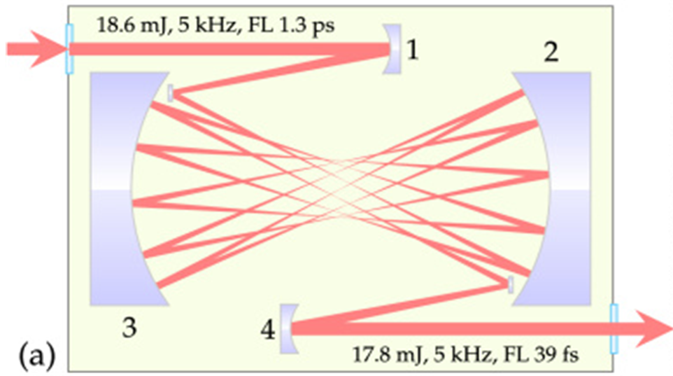
The Multipass Cell
A multipass cell uses a pair of convex mirrors to pass a pulse back and forth, lengthening its travel distance. The travel distance is mathematically related to the beam waist, fluence, and Rayleigh range, which are related to the pulse duration.
Lengthening the travel distance will compress the pulse!
Up to this point, nonlinear pulse compression has only been performed on 18 mJ pulses, and for the CXLS a 500 mJ pulse was needed.
Multipass Cell- - Kaumanns et al., 2018
My goal was to use MATLAB to simulate this nonlinear compression.

Slide 5
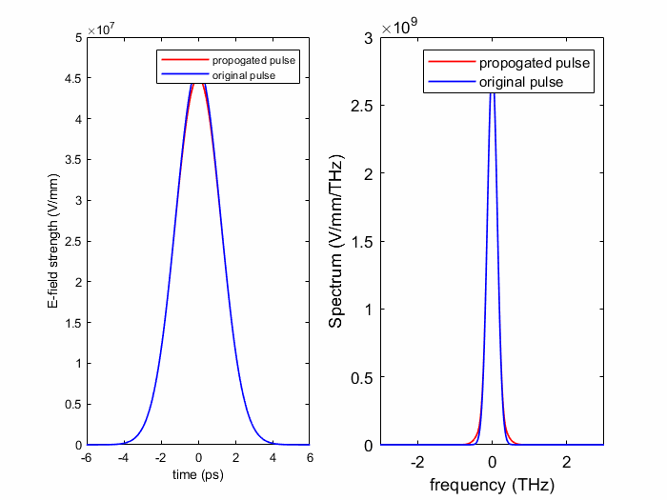
Methods and Results
These calculations required use of the numerical parameters of the laser: input pulse energy & duration, beam diameter, & wavelength.
At the time of calculation using those laser parameters, I calculated that a cell length of 18 m could produce a pulse duration of 50 fs. I simulated this in MATLAB using self-phase modulation (SPM), a process describing how a pulse traveling in a medium will vary the medium’s refractive index, giving the pulse a phase shift. This changes the pulse’s frequency and intensity spectrum, as shown on the right.
Electric field undergoing phase shifts
Spectral broadening of intensity spectrum

Slide 6
Conclusions
This simulation is helpful because it helps us test out our parameters.
All this planning really becomes meaningful when we start answering certain questions, such as “how long will the cell be” and “how many passes of the multipass cell will we need”. According to our calculations, at these current parameters we should end up with a cell length of about 18 m. However, at lower levels of pulse energy, a much shorter cell could be achieved.
This shows how the laser’s properties can be modified using an extra tool in order to better fit the parameters and geometry of the setup.
Acknowledgements
Many thanks to my mentor Dr. Teitelbaum, my co-undergraduate Dariannette Valentin, and graduate student Sean Tilton, who are the best guides through the confusing world of condensed matter physics.
The material contained in this document is based upon work supported by a National Aeronautics and Space Administration (NASA) grant or cooperative agreement. Any opinions, findings, conclusions or recommendations expressed in this material are those of the author and do not necessarily reflect the views of NASA. This work was supported through a NASA grant awarded to the Arizona/NASA Space Grant Consortium.

Slide 7
Thank you!

